Slide 1

DEPARTMENT OF COMPUTER SCIENCE AND ENGINEERING
IPL WINNING PREDICTOR USING MACHINE LEARNING 0=,
Under the Guidance of
N.SATYANANDARAM
(Lecturer)
A.SRAVAN KUMAR -R190303
B.RUCHITHA -R190680

Slide 2
Outline
Introduction
Objective
Motivation
Related Works
Methodology
Workflow
Results and Experimental Analysis
Discussions and Conclusion
References

Slide 3
ABSTRACT
Introduction:
This project focuses on using machine learning to predict the outcome of Indian Premier League (IPL) cricket matches, known for their unpredictability. Through a multivariate regression-based approach, the study identifies key factors influencing match results and proposes seven attributes for prediction. Various machine learning models, including Random Forest and Decision Tree, are trained and evaluated in real time scenarios. The project demonstrates the effectiveness of machine learning in sports analysis, offering insights into enhancing prediction accuracy in dynamic sporting environments like the IPL.

Slide 4
Features:
Machine Learning Models : Employing various machine learning models such as Random Forest and decision tree for training and evaluating prediction performance.
Effectiveness Of Machine Learning : Demonstrating the effectiveness of machine learning techniques in sports analysis, specifically in predicting match outcomes in dynamic sporting environments like the IPL.
Identification Of Key Factors : Identifying the key factors that influence the results of IPL matches, crucial for accurate prediction.

Slide 5
Insights Of Prediction Enhancement : Offering insights gained from the study to enhance prediction accuracy in unpredictable events like the IPL , contributing to advancements in sports analytic.
Real-Time Scenario Evaluation : Conducting real time Scenario evaluations to assess the performance and reliability of the machine learning models in predicting IPL match outcomes.
Stack
- Python
- Machine Learning
- Matplotlib , Seaborn ,Scikit-learn, NumPy and Pandas
- Jupyter Notebook

Slide 6
Introduction
Overview
Predicts the outcome of Indian Premier League (IPL) matches.
Utilizes historical match data and advanced machine learning techniques.
Aims to provide accurate and reliable predictions.
Benefits teams, analysts, fans, and fantasy league participants.

Slide 7
Scope
Comprehensive Data Analysis: Utilizes extensive historical data, including past match results, player statistics, pitch conditions, weather forecasts, and more.
Machine Learning Techniques: Implements advanced algorithms such as Random Forest, Gradient Boosting, SVM, and Neural Networks for accurate predictions.
Real-Time Updates: Capable of integrating real-time data during matches to provide dynamic and up-to-date predictions.
User Engagement: Offers a user-friendly interface for teams, analysts, and fans to access predictions and insights easily.
Strategic Insights: Provides valuable information for team strategy, player selection, and match preparation.

Slide 8
Objective
Improve Accuracy: Develop a highly accurate prediction model.
Key Factors: Identify crucial elements influencing match outcomes.
Real-time Predictions: Enable dynamic updates during matches.
User-Friendly: Create an easy-to-use interface for various users.
Comprehensive Analysis: Cover all aspects influencing a match, such as player form, pitch conditions, and weather.

Slide 9
Motivation
Traditional methods are subjective and limited.
Machine learning processes vast data for better predictions.
Objective and data-driven approach enhances reliability.
Bridges the gap between raw data and actionable insights.

Slide 10
Literature
Introduction to Literature
Early Approaches: Initial methods for predicting cricket match outcomes relied on basic statistical analysis of player and team performances.
Shift to Machine Learning: The advent of machine learning brought more sophisticated models capable of analyzing vast datasets and identifying complex patterns.
Purpose: Review key studies and methodologies used in the prediction of cricket match outcomes, specifically focusing on the IPL.

Slide 11
Insights and Emerging Trends
Player Performance Prediction: Passi et al. predicted player performance based on runs and wickets using Random Forest, outperforming other algorithms.
Trait Analysis: Nigel Rodrigues et al. used Multiple Random Forest Regression to predict player traits in current matches, aiding in player selection.
Fixture Prediction: Wright used Subcost-Guided Simulated Annealing (SGSA) to predict fair and efficient match fixtures.
Comprehensive Models: Shetty et al. achieved varying accuracies (76% for batsmen, 67% for bowlers, 96% for all-rounders) using Random Forest, incorporating multiple factors like ground, pitch, and opposition.

Slide 12
Contribution
Predicting the winner of the Indian Premier League (IPL) involves several key factors. Here are the main contributions to an IPL winning prediction :
Team Strength: This includes the overall skills and abilities of the players in a team. Teams with strong batsmen, bowlers, and fielders have a higher chance of winning.
Current Form: The recent performance of the team and its players. Teams that have been performing well in the recent matches are likely to continue their winning streak.
Head-to-Head Record: Past matches between the two teams. A team that has historically won more matches against a particular opponent might have a psychological advantage.
Home Advantage: Playing at their home ground often gives teams an edge due to

Slide 13
familiar conditions and local crowd support.
Pitch Conditions: The nature of the pitch can significantly influence the game. Some pitches favor batsmen, while others help bowlers. Knowing the pitch conditions helps in predicting the outcome.
Weather Conditions: Weather can affect the match, especially in terms of rain or dew, which can impact the playing conditions and strategies.
Player Injuries: Injuries to key players can weaken a team’s chances of winning. Keeping track of player fitness is crucial.
Team Morale: The overall confidence and unity of the team. A team with high morale is more likely to perform well under pressure.
Captaincy and Leadership: The role of the captain and the leadership qualities can make a significant difference, especially in crucial moments of the game.

Slide 14
Methodologies:
Data Collection and Cleaning
Exploratory Data Analysis (EDA) and Feature Engineering
Model Selection and Training
Model Evaluation
Model Deployment and Visualization
Continuous Improvement

Slide 15
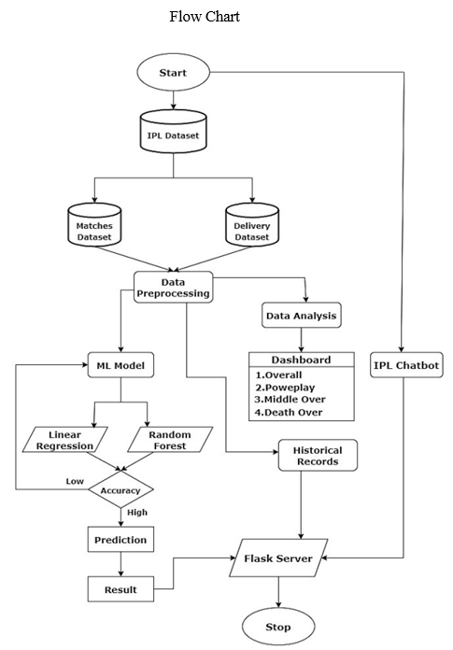
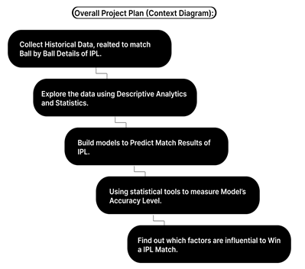
Fig: PROJECT PLAN

Slide 16
Data Collection and Cleaning
Collect Match Data:
Gather past IPL match details, including scores and results.
Collect Player Data:
Gather individual player statistics, like batting and bowling averages.
Collect Team Data:
Gather team performance records, including win/loss history.
Collect Pitch and Weather Data:
Gather information on pitch conditions and weather during matches.
Clean and Standardize Data:
Remove duplicates, handle missing values, and ensure consistency in format.

Slide 17
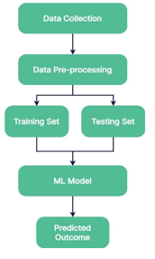
Fig: Steps in Model Development

Slide 18
Exploratory Data Analysis (EDA)
Understand Data Distribution:
Analyse data summaries like averages and ranges.
Identify how data is spread out.
Visualize Data:
Use charts and graphs (e.g., bar charts, scatter plots) to spot patterns and trends.
Look for relationships between variables.
Detect Outliers:
Identify unusual data points that might affect predictions.
Investigate any anomalies found

Slide 19
Feature Engineering
Select Relevant Features:
Choose key data points that influence match outcomes (e.g., player stats, recent team performance).
Create New Features:
Generate useful metrics (e.g., average scores per match, recent player form).
Standardize and prepare features for modeling.

Slide 20
Model Selection and Training
Choose Models:
Select appropriate machine learning algorithms (e.g., decision trees, random forests).
Consider ensemble methods for better accuracy.
Prepare Data:
Split data into training and testing sets.
Format data for training models.
Train Models:
Feed data into chosen models to learn patterns.
Adjust model parameters for better performance.

Slide 21
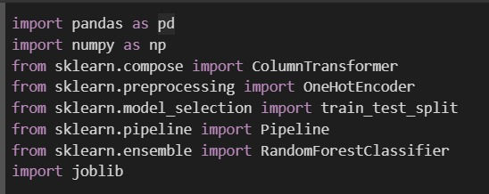
Fig: Importing Libraries

Slide 22
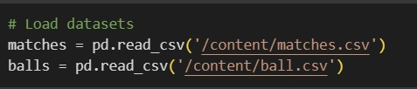
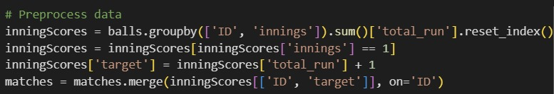
Fig : Data Loading
Fig : Data Preprocessing

Slide 23
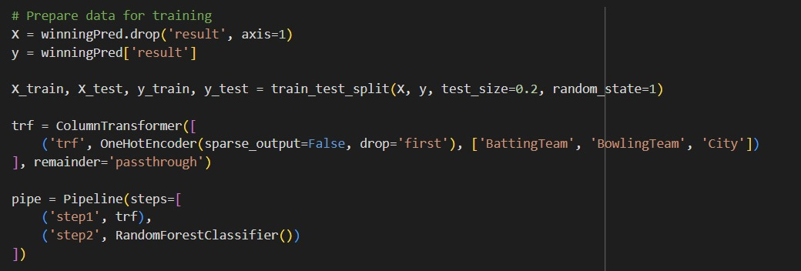
Fig: Training The Model

Slide 24
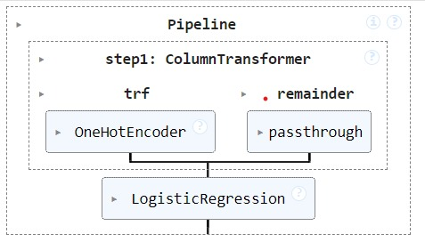
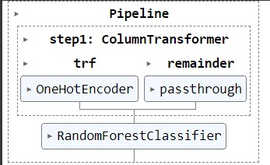
Fig: Logistic Regression
Fig: Random Forest Classifier

Slide 25
Evaluate Performance:
Use testing data to assess how well models predict outcomes.
Measure accuracy and other metrics to gauge performance.
Optimize :
Fine-tune models by adjusting parameters.
Use cross-validation to validate model robustness.
Finalize Model:
Select the best-performing model.
Prepare for deployment and future predictions

Slide 26
Model Evaluation
Use Testing Data:
Evaluate the model's predictions on a separate testing dataset.
Metrics:
Measure performance using metrics like accuracy, precision, recall, and F1-score.
Cross-Validation:
Validate model consistency across different data subsets.
Compare and Select:
Compare models to choose the most accurate one for IPL predictions.
Adjust for Accuracy:
Fine-tune the model based on evaluation results

Slide 27
Model Deployment and Visualization
Prepare Model for Deployment:
Finalize the trained model for operational use.
Ensure compatibility with deployment environments.
User Interface Development:
Create a user-friendly interface for inputting new data and receiving predictions.
Consider usability and accessibility.
Visualization of Predictions:
Develop visualizations (e.g., charts, graphs) to illustrate predicted outcomes.

Slide 28
Testing:
Conduct thorough testing of the deployed model and interface.
Verify accuracy and reliability of predictions in real-world scenarios.
Deployment:
Deploy the model and interface to production.
Monitor performance and gather feedback for continuous improvement.

Slide 29
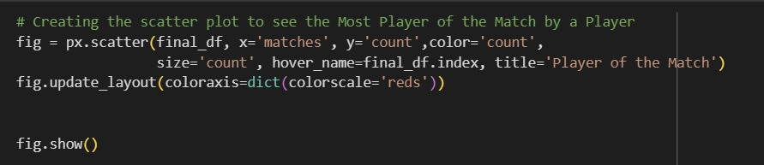
Fig: Data Visualisation

Slide 30
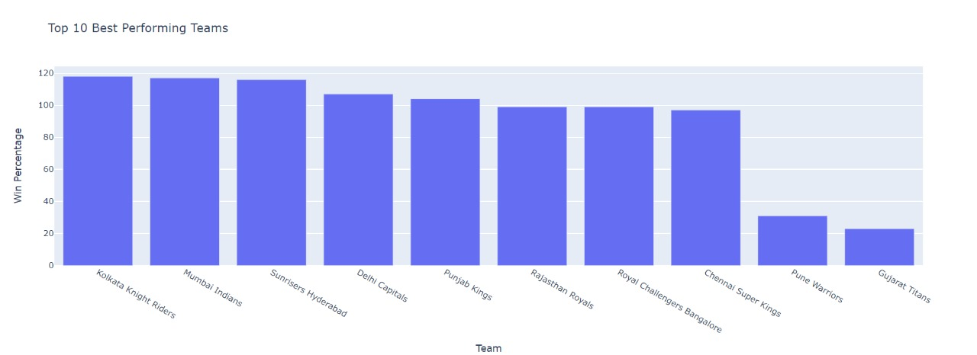
Fig: Team Performances

Slide 31
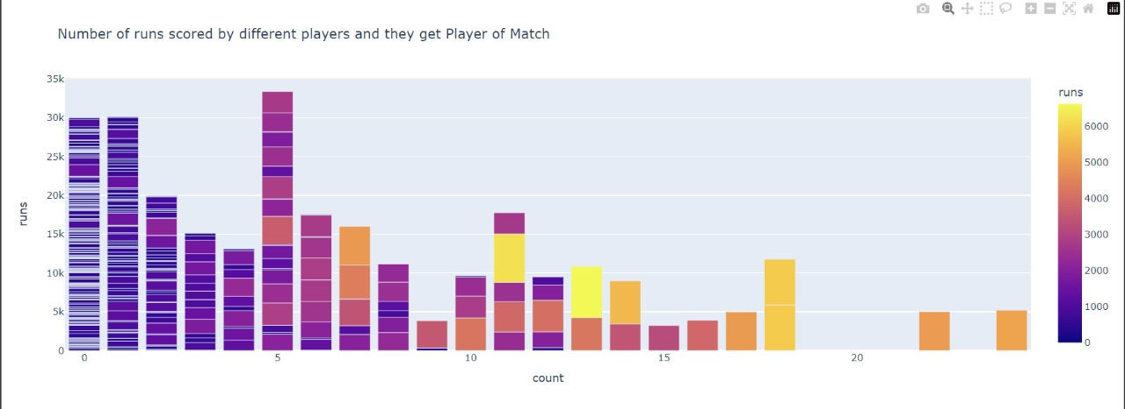
Fig: Runs Scored By Players And Player Of The Match

Slide 32
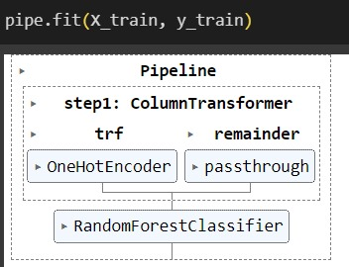
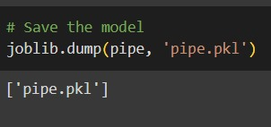
Fig: Fitting The Model
Fig : Save The Model

Slide 33
Continuous Improvement
Data Updates:
Regularly update model with new match and player data.
Ensure data remains current for accurate predictions.
Feedback Integration:
Incorporate user and stakeholder feedback to refine predictions.
Use feedback to identify and address areas for improvement.
Performance Monitoring:
Continuously monitor model performance.
Adjust model based on changes in prediction accuracy.
Refinement:
Refine algorithms and features to enhance prediction capabilities.

Slide 34
Conclusion and Future Enhancements
Effective Predictions: Using machine learning, we accurately predict IPL match winners based on player and team data.
Key Factors: Player performance, team form, pitch conditions, and historical trends are critical for predictions.
Continuous Improvement: Regular updates and user feedback refine models, improving prediction accuracy.
Enhanced Insights: These predictions assist fans, analysts, and teams in making informed decisions and strategies.
Future Developments: Advancements in data analysis and AI will further refine predictions, making them even more precise and valuable in upcoming IPL seasons

Slide 35
THANK YOU

